Slide 1

LOW COST - 2

Slide 2
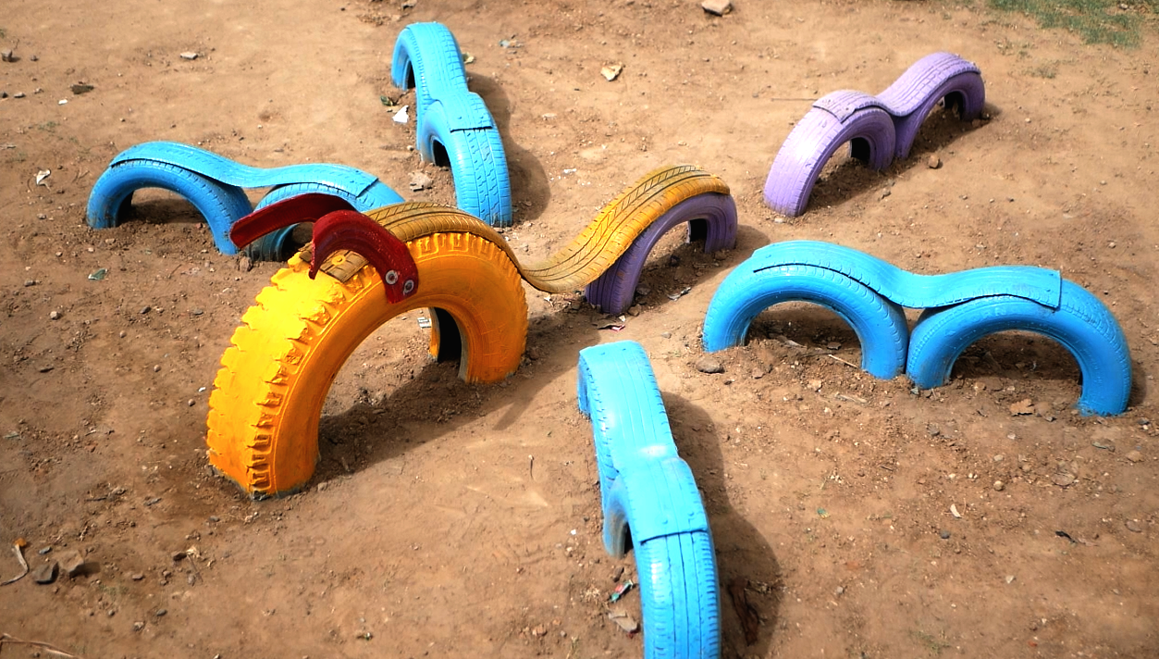
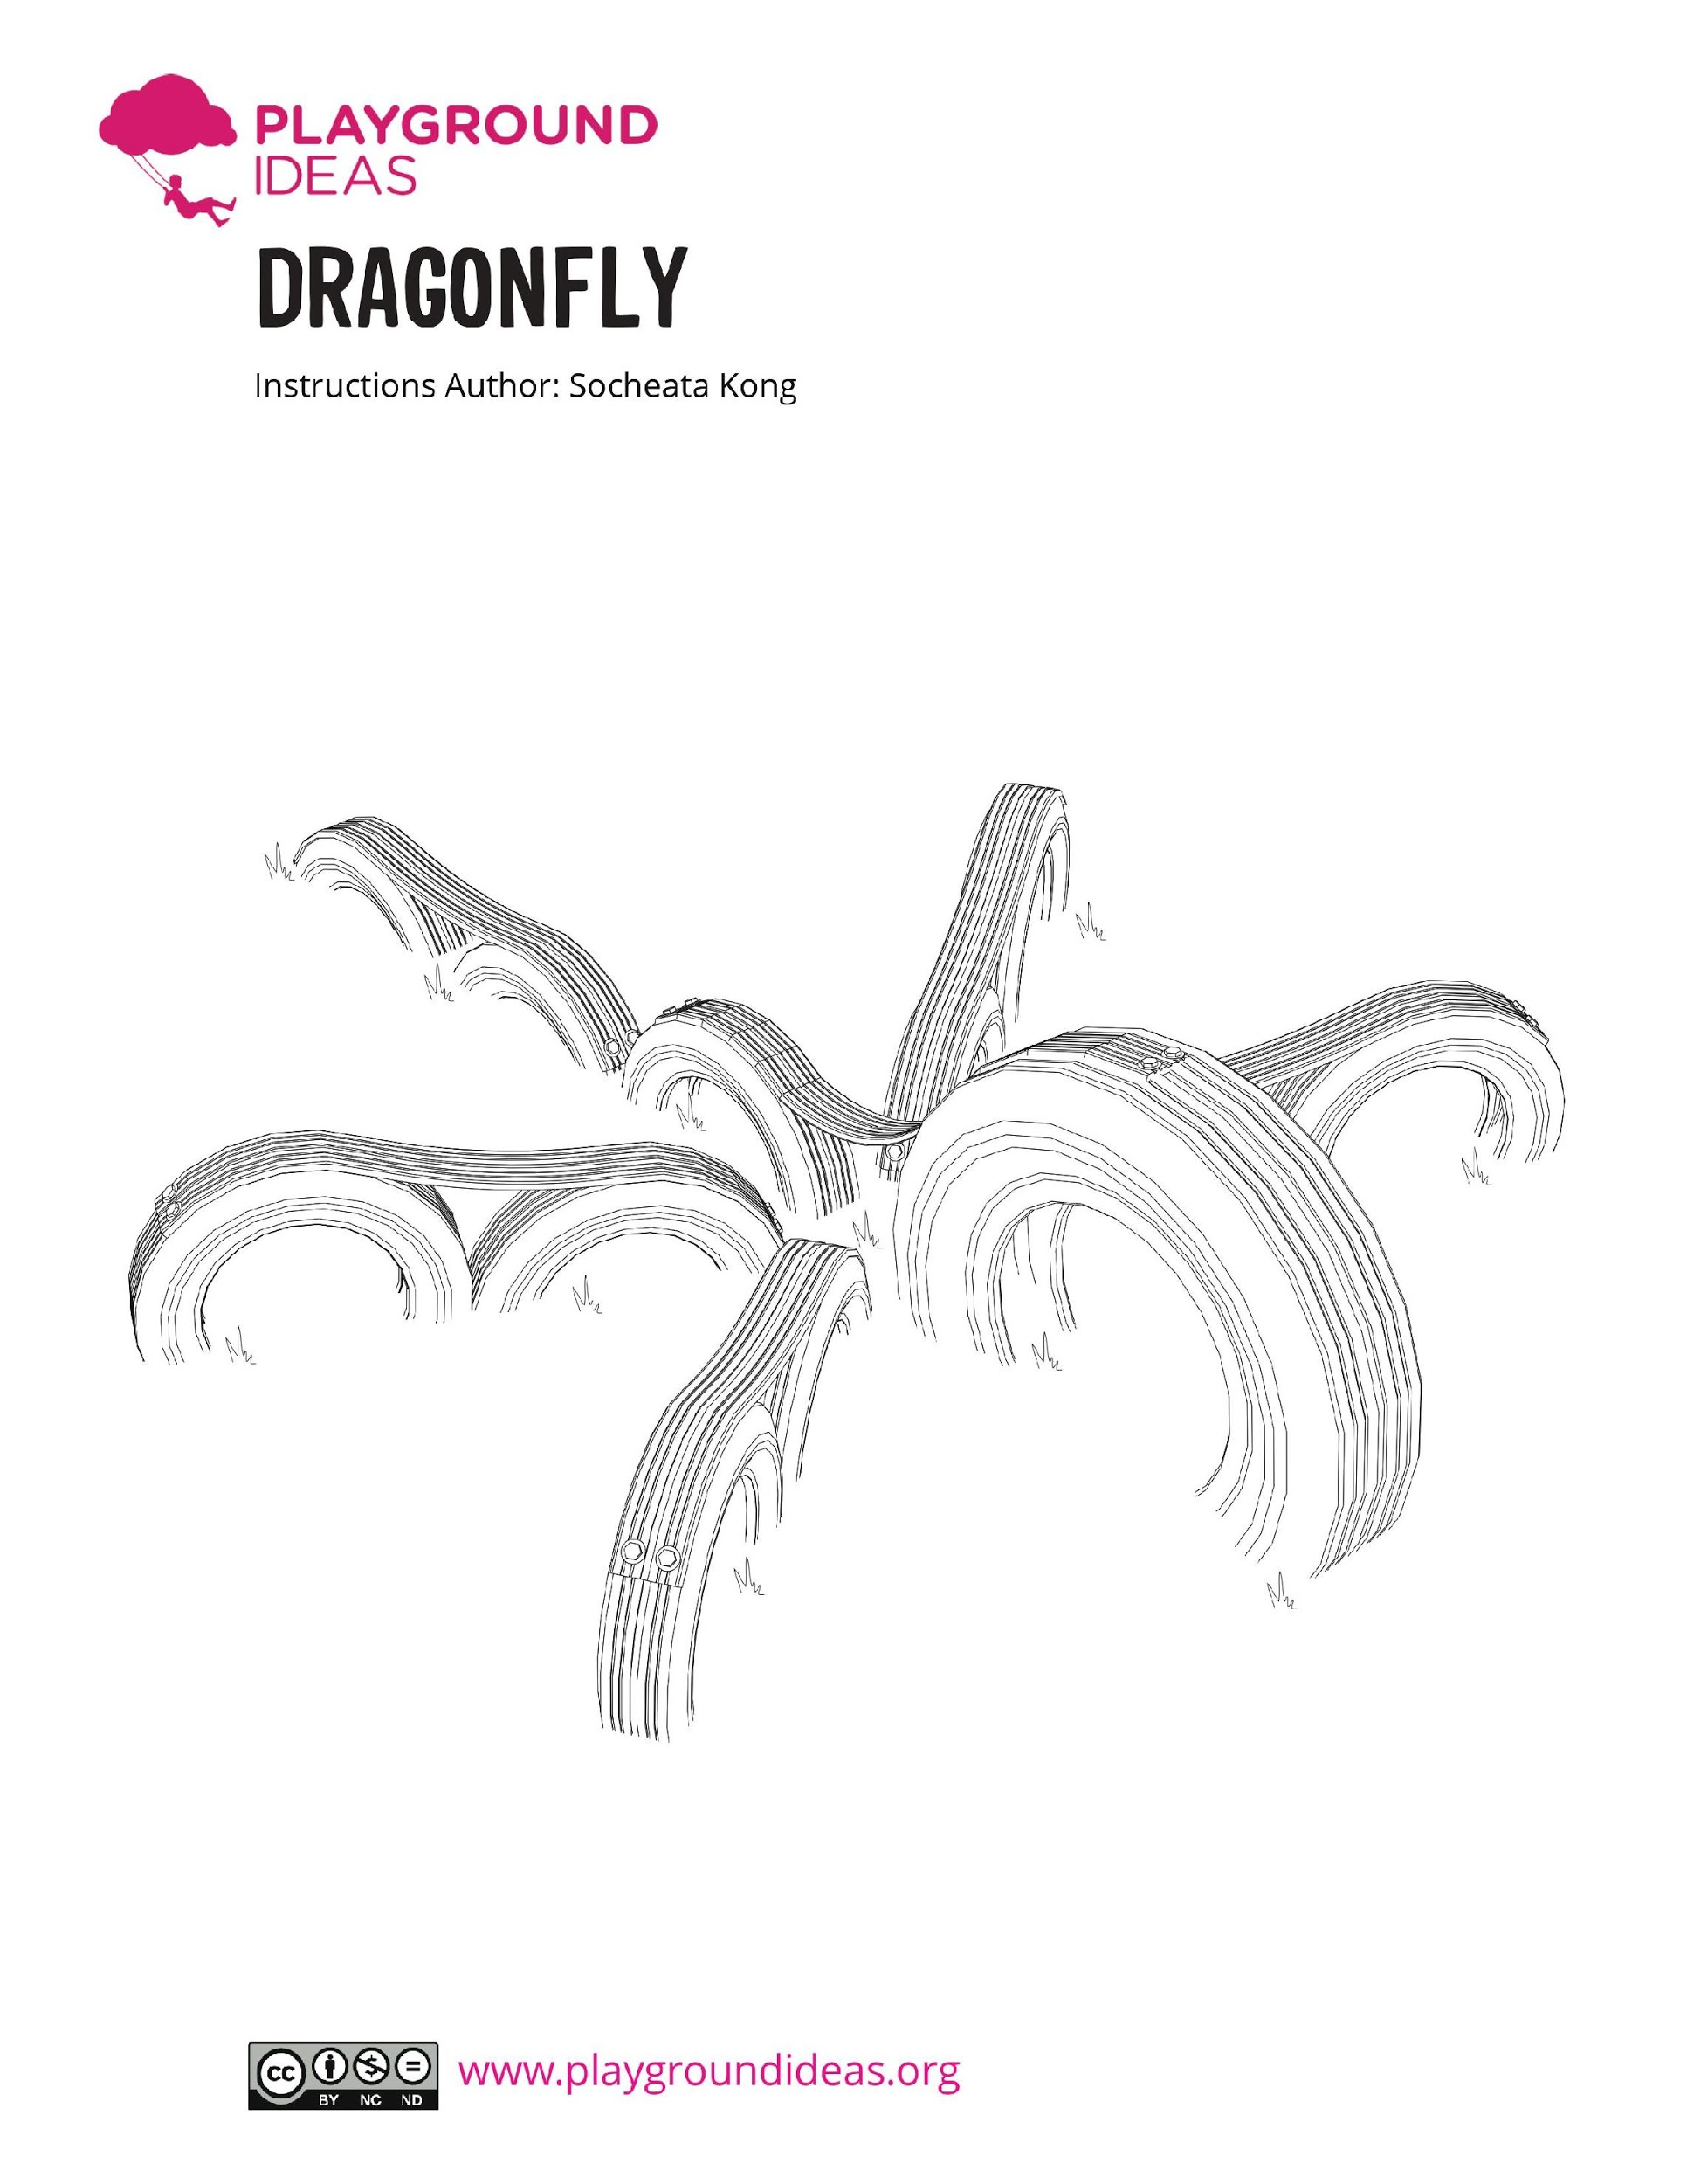

How do we perceive a dragonfly?
DRAGONFLY
Number of Users: 4-5
Material: Tyres

Slide 3
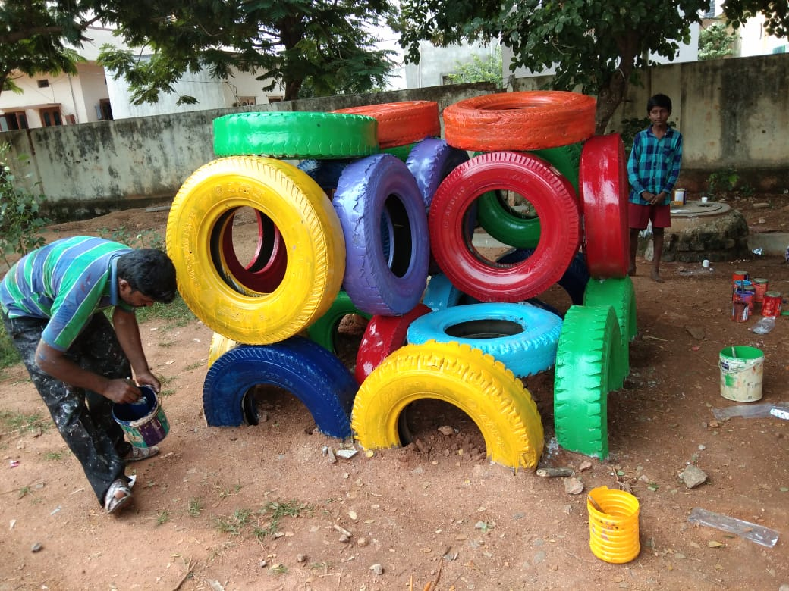
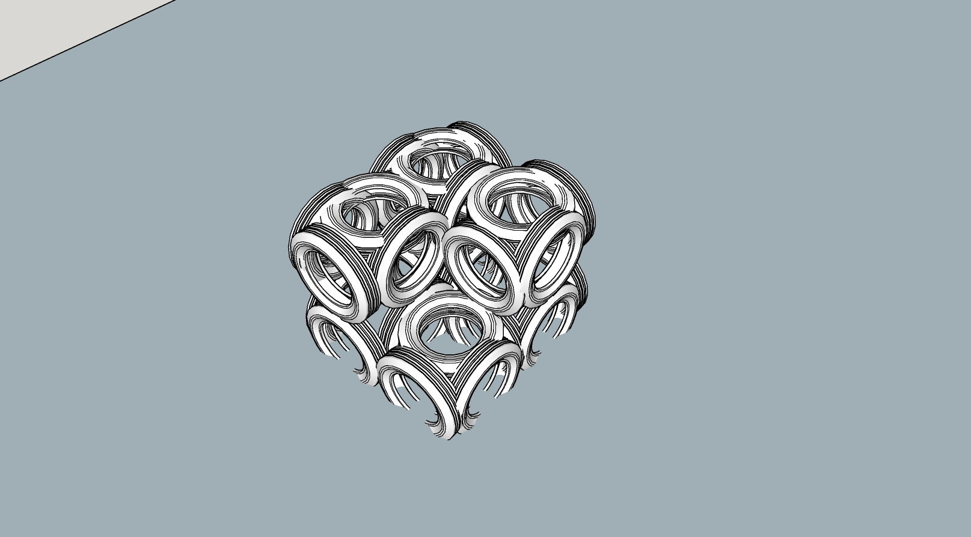
How do we perceive Cube Jumper?
ELEMENT C: Cube Jumper
Material: 25 Truck Tyre
Procedure:
Step 1 - Marking
Step 2 - Digging
Step 3 - Drilling
Step 4 - Bolting
Step 5 - Painting

Slide 4
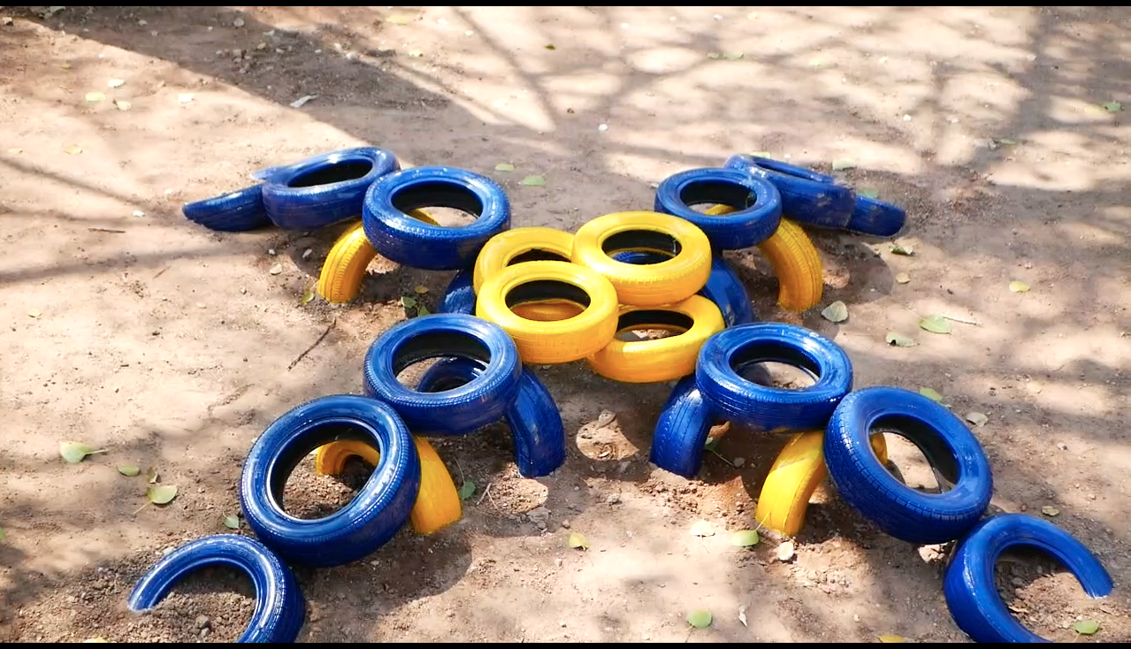
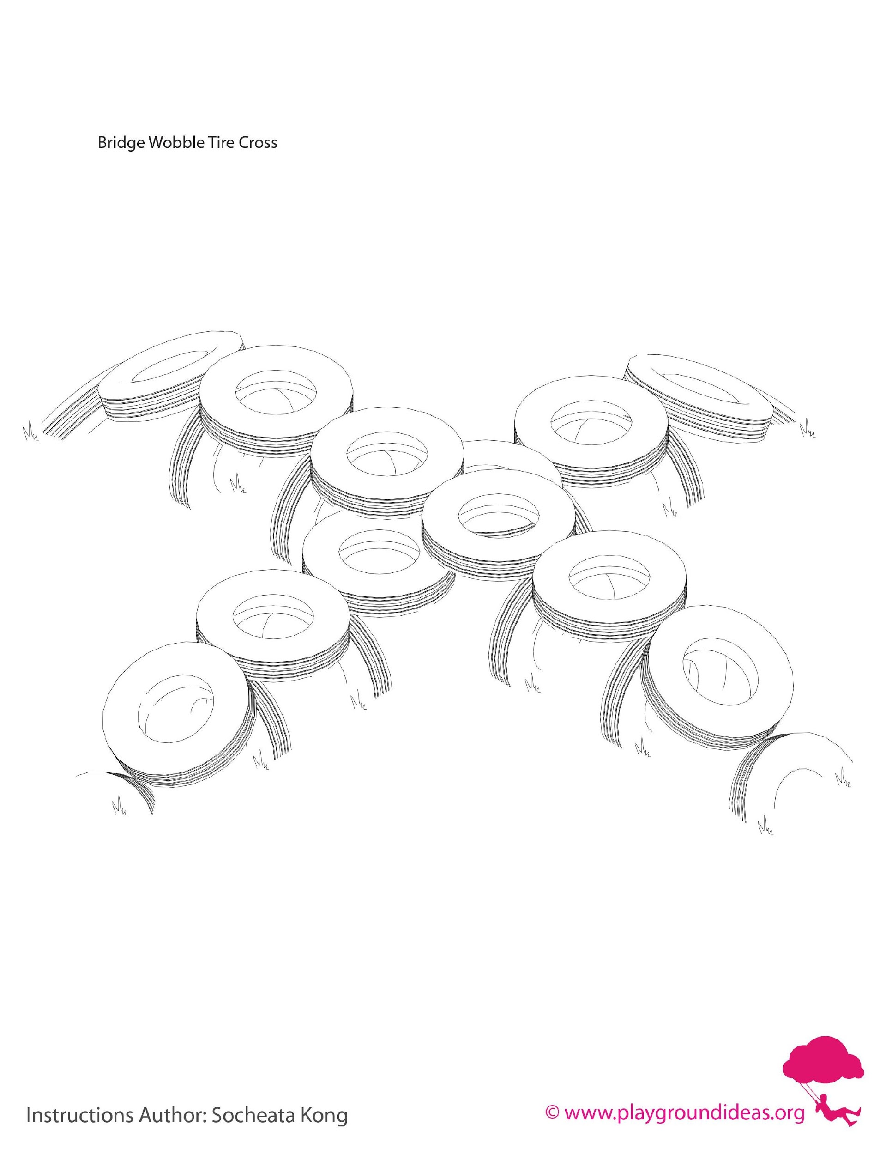
How do we perceive a bridge wobble cross?
BRIDGE WOBBLE CROSS
Number of Users : 7-8
Material: Tyres

Slide 5
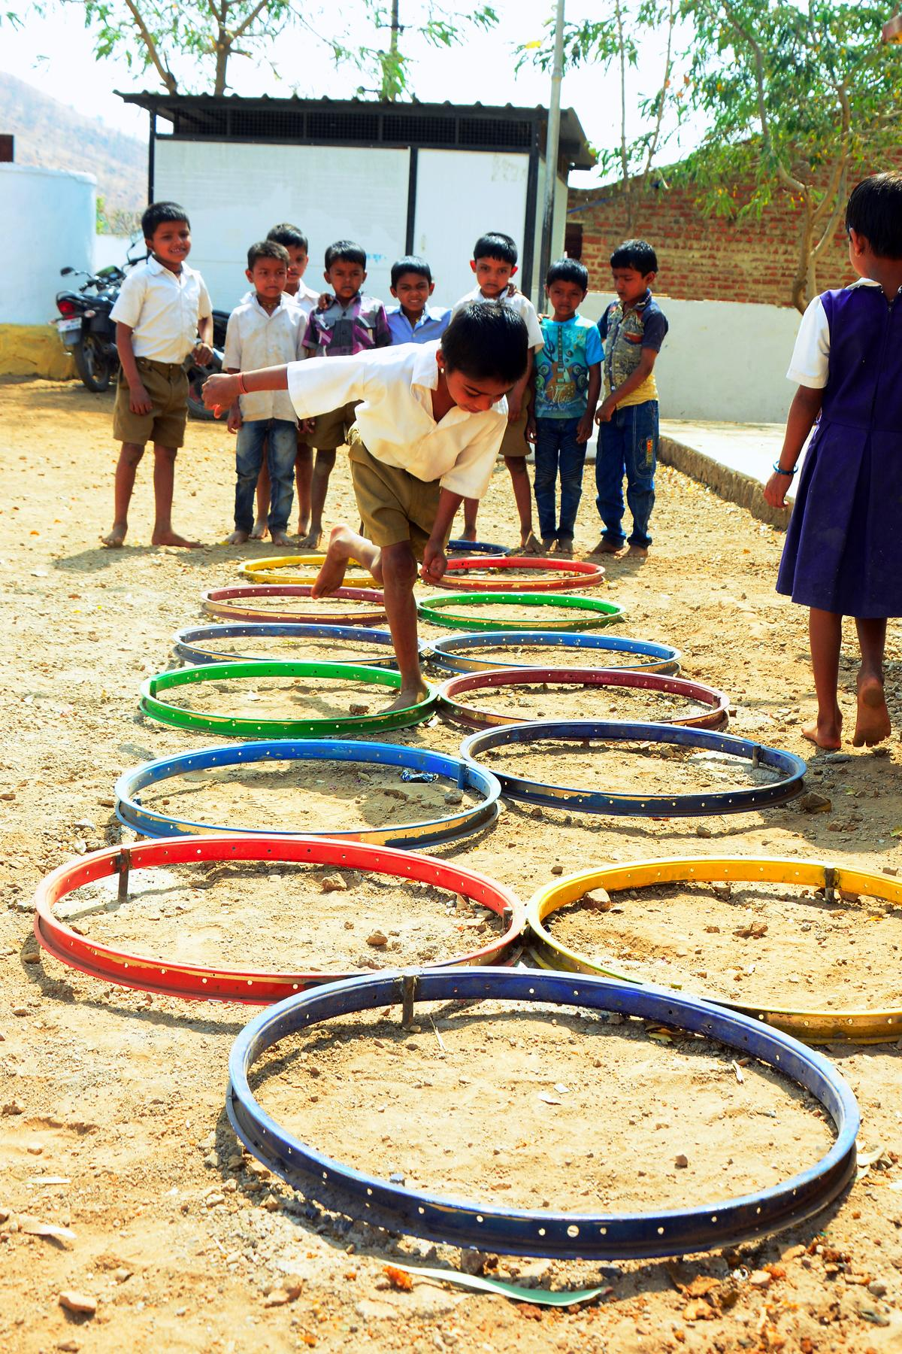
cycle rim HOPSCOTCH
Hopscotch is an activity where kids would use both their legs and two sides of their brains accordingly.
note : The following image explains the idea of the element and the following element, will be further detailed out to fit site context.

Slide 6
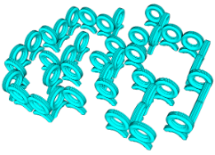
MEGA MAZE

